Slide 1
1교시: 딥러닝 개관
언어학과 신운섭

Slide 2
딥러닝의 문제들
과적합 (Overfitting)
기울기 소실 (Vanishing Gradient)

Slide 3
Overfitting
:학습데이터에 대하여는 예측정확도가 높지만, 실제 테스트데이터에 대
하여 예측정확도가 떨어지는 것
1.테스트셋과 학습셋의 중복
(k-fold cross validation, Large Data size and Early stopping)
2.변수의 복잡성
(Occam’s Razor, Curse of Dimensionality and Data Sparseness) 3. 많은 은닉층(Dropout)

Slide 4
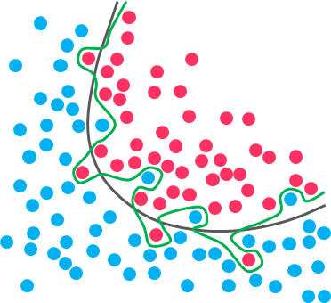
Overfitting

Slide 5
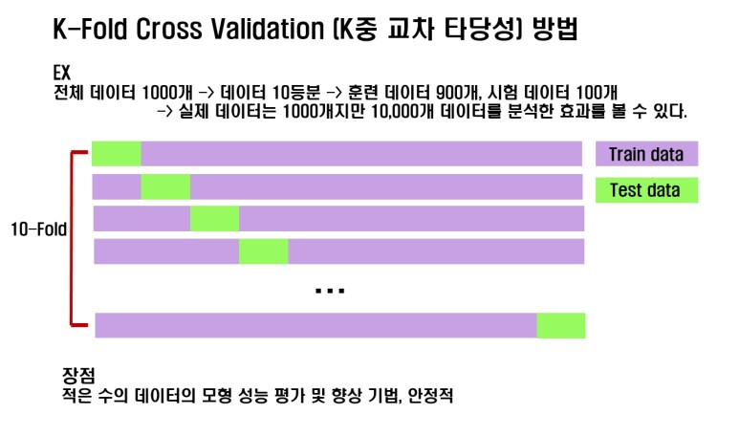

Slide 6
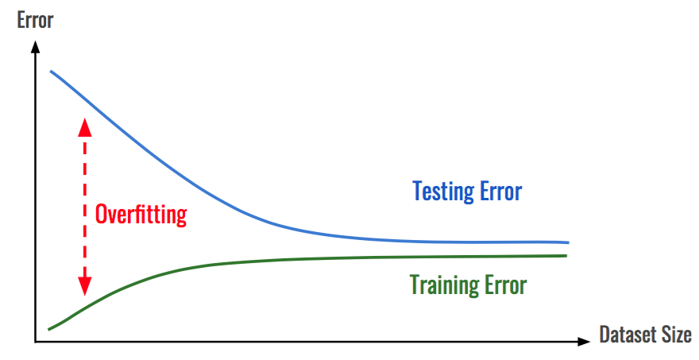
Overfitting and Large Dataset Size

Slide 7
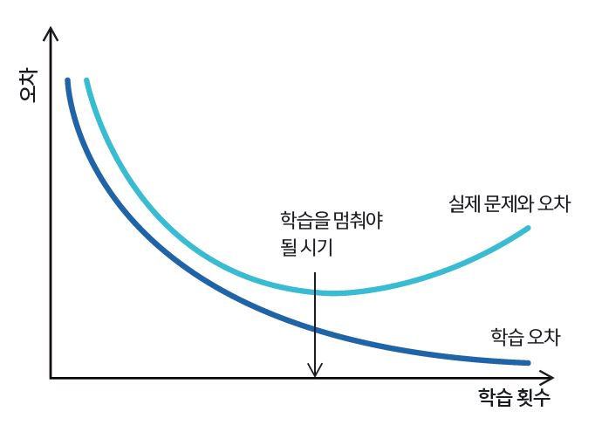
Overfitting and Early Stopping
학습 횟수 = Epoch
“인간이 정하는 Hyperparameter”

Slide 8
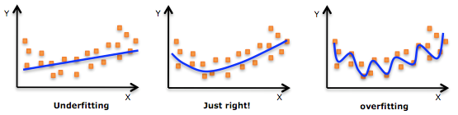
Overfitting and Occam’s Razor

Slide 9
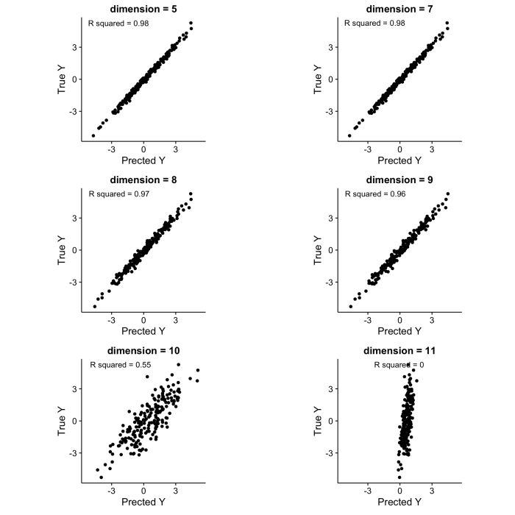
Overfitting and Curse of Dimensionality
“Orthogonal” or “Tangential”

Slide 10
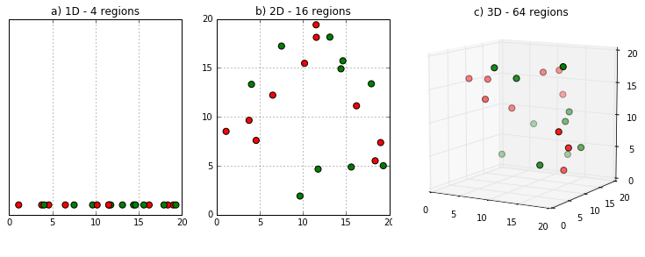
Data Sparsity Problem(also Data Sparseness)
Another Look at the Data Sparsity Problem. Ben Allison et al
“In natural language processing, data sparsity (also known by terms such as data sparseness, data paucity, etc) is the term used to describe the phenomenon of not observing enough data in a corpus to model language accurately.”

Slide 11
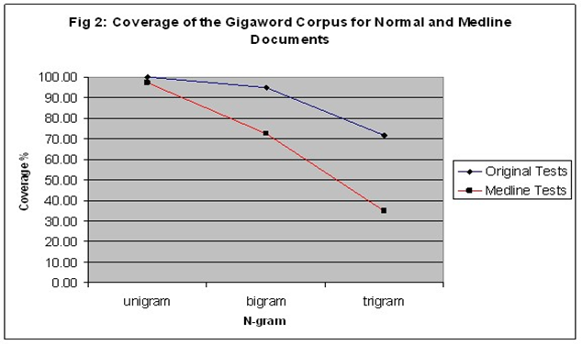

Slide 12
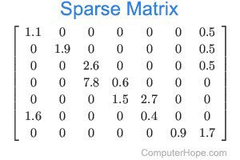
Manifold Hypothesis and Word Embeddings

Slide 13
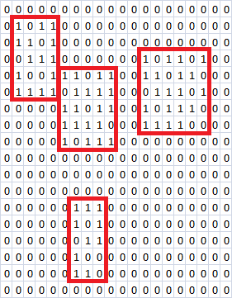
Sparse Matrix and Dense Matrix

Slide 14
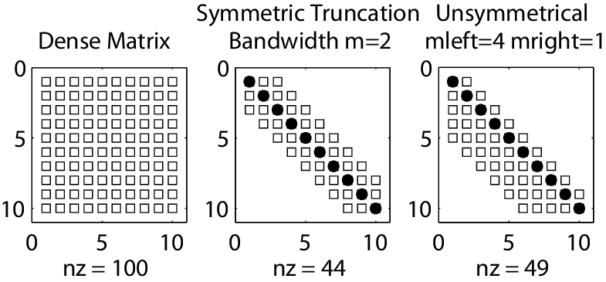
Extracting Principal Features

Slide 15
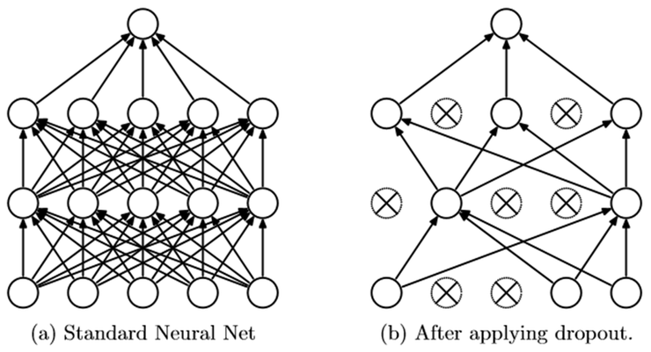
Overfitting and Dropout
“Kill half the nodes”
drop out rate = 0.5

Slide 16
딥러닝의 문제들
기울기 소실(Vanishing Gradient) and 활성함수(Activation Function) :최적화(또는 오차역전파) 과정에서 가중치 행렬이 업데이트되지 못하고 퍼셉트론의 노드가 죽어버리는 현상. 따라서 모델의 일반화(예측) 능력에 한계 발생.
Predictive Modelling: Linear Regression
Predictive Modelling: Logistic Regression = “Perceptron” = Activation function

Slide 17
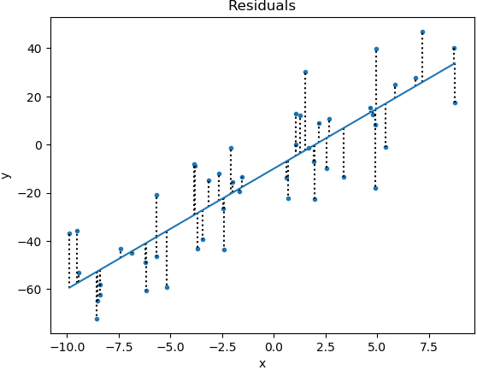

Slide 18
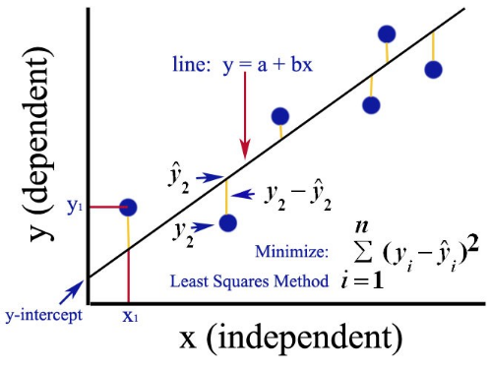
Linear Regression and Mean-Squared Error(MSE)

Slide 19
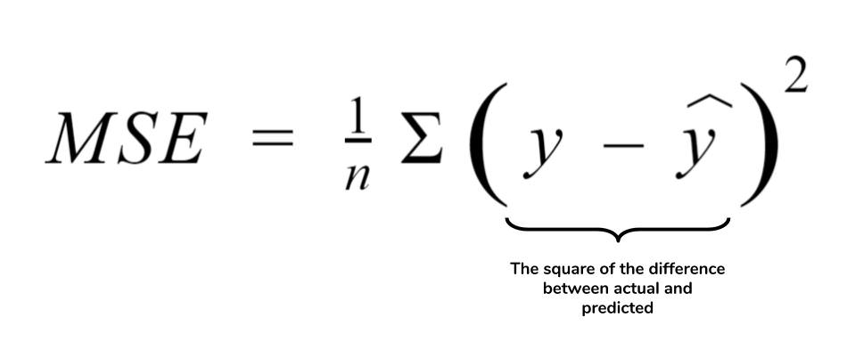
Gradient Descent and Loss Function
Loss Function(or Cost Function)
=목적함수, 손실함수, 오차함수 등등

Slide 20
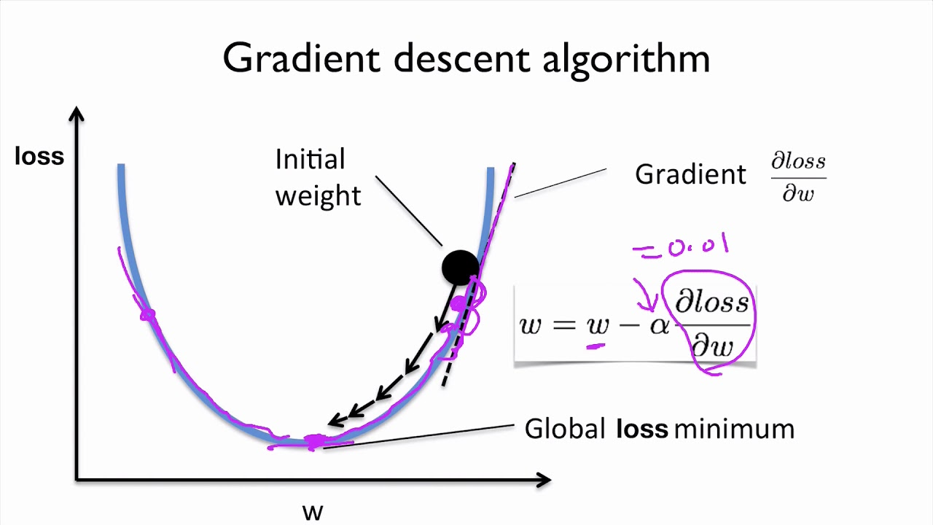
Optimization through Gradient Descent

Slide 21
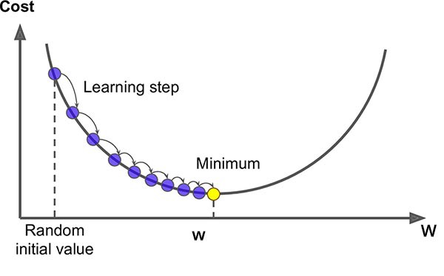
Gradient Descent
Another Hyperparameter = Learning step or Learning rate
Find the point where derivative of Loss function is zero

Slide 22
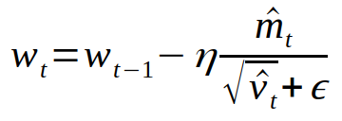
Advanced Gradient Descent Method
Optimizer = ‘Adam’

Slide 23
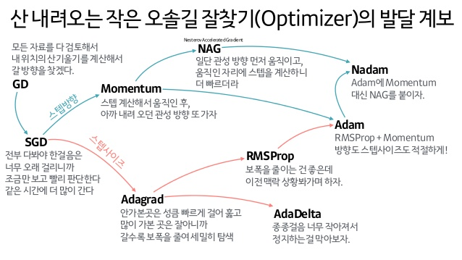

Slide 24
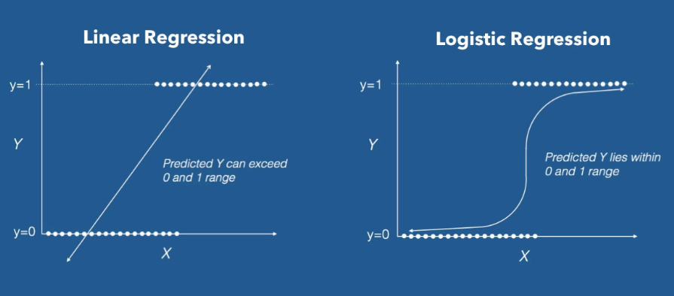
Logistic Regression = Binary Classification
True = 1 False = 0

Slide 25
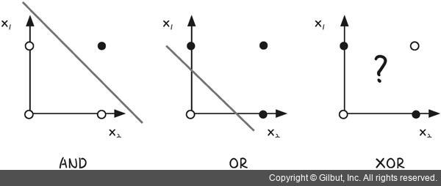
XOR Problem
One Layer consists of one logistic regression is Not Enough

Slide 26
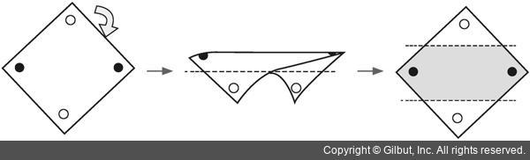
Multi Layer Perceptron(MLP)

Slide 27
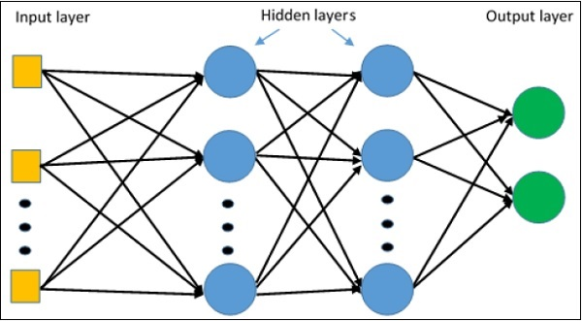

Slide 28
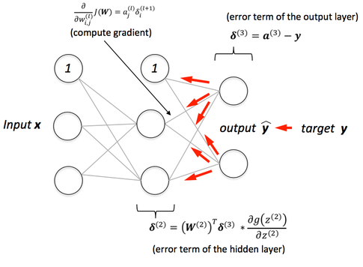
Feed Forward and Back Propagation

Slide 29
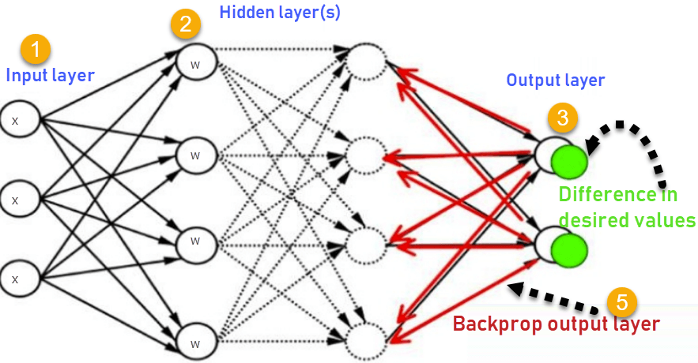

Slide 30
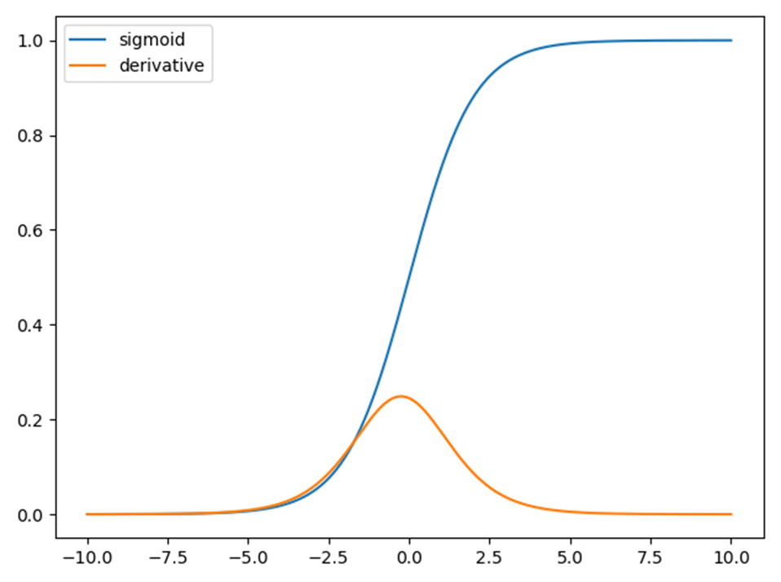
Another problem: Vanishing Gradient
Gradient of Loss function disappears during optimization process since the added hidden layer multiplies derivative of activation function, which is, sigmoid.

Slide 31
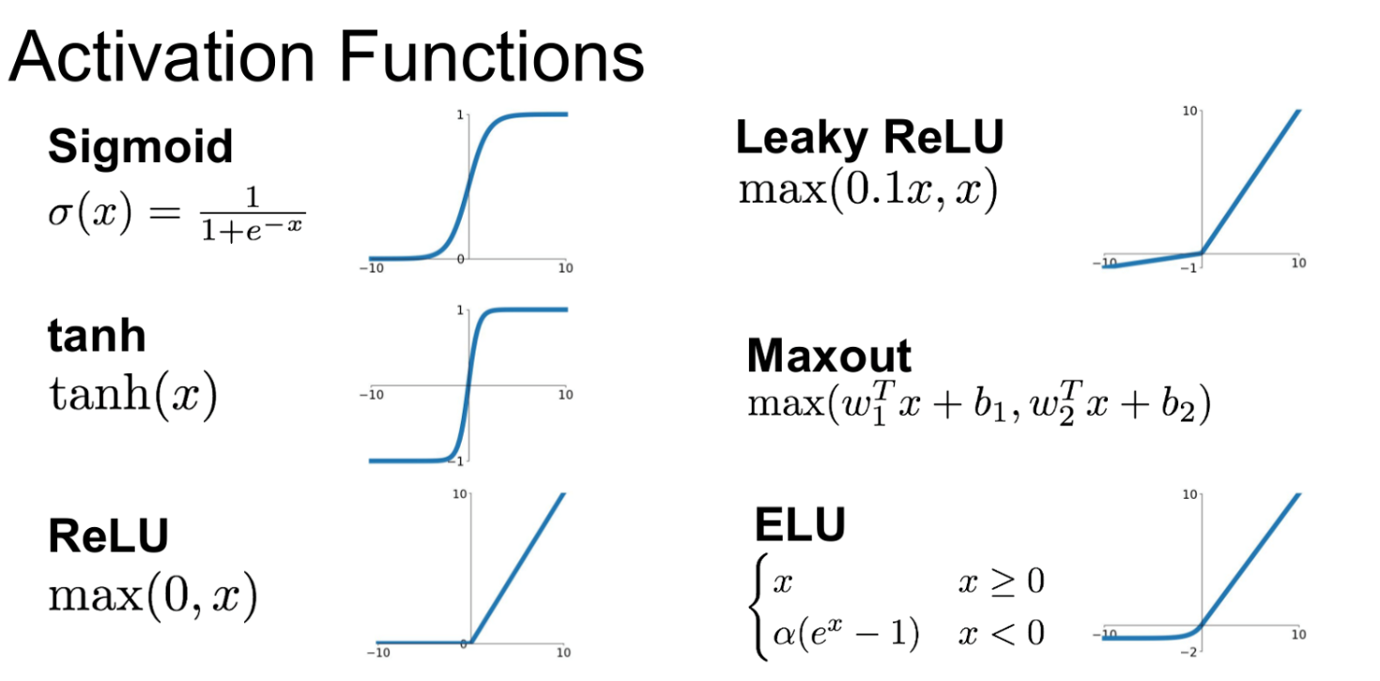
The Hidden Layer Activation Function → Perceptron = ReLU for RNN

Slide 32
감사합니다!

